Slide 1

Люди vs. Роботи: як роботизація та автоматизація змінить сферу розробки програмного забезпечення та управління проектами
Oleksandr Krakovetskyi CEO, DevRain Solutions @msugvnua alex.krakovetskiy@devrain.com https://fb.com/alex.krakovetskiy

Slide 2
About
CEO of DevRain Solutions.
CTO DonorUA.
Microsoft Regional Director.
Microsoft Most Valuable Professional.
Best Professional in Software Architecture (Ukrainian IT Award).
Ph.D. in Computer Science.

Slide 3
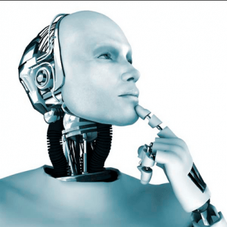
Humans vs. Robots
Sony Pictures replaced 70 human operators with one AI chat bot
http://www.businessinsider.com/startup-msgai-wants-to-make-bots-big-2016-3
iPhone manufacturer Foxconn plans to replace almost every human worker with robots
http://www.theverge.com/2016/12/30/14128870/foxconn-robots-automation-apple-iphone-china-manufacturing

Slide 4
Humans vs. Robots
The Robots Win: Blackrock Bets On Computers Over Human Stock Pickers, Fires Dozens http://www.zerohedge.com/news/2017-03-28/robots-win-blackrock-bets-computers-over-human-stock-pickers-fires-dozens
AI learns to write its own code by stealing from other programs https://www.newscientist.com/article/mg23331144-500-ai-learns-to-write-its-own-code-by-stealing-from-other-programs/

Slide 5
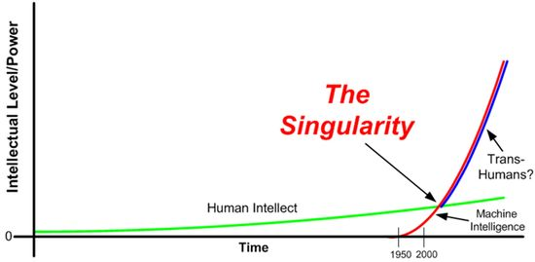
Technological singularity
The hypothesis that the invention of AI will abruptly trigger runaway technological growth, resulting in unfathomable changes to human civilization.

Slide 6
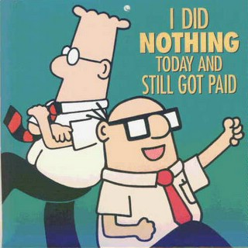
”Put a computer in a robot body and it can walk from cubicle to cubicle handing out assignments, checking on progress, and adjusting schedules and budgets on the fly. A robot could easily juggle the complexity of dozens of projects. It could be talking to you in your cubicle while simultaneously having a phone call with another employee and texting a third without you even knowing as it happens.” Scott Adams, the author of the Dilbert cartoons

Slide 7
Project estimation and resources allocation
A human manager will tell his boss what the boss wants to hear.
A robot will be entirely objective, creating estimates based on similar projects from history.
The robot won’t fear being fired if he tells the boss the project won’t be done before the CEO visits. For the robot, facts are facts.

Slide 8
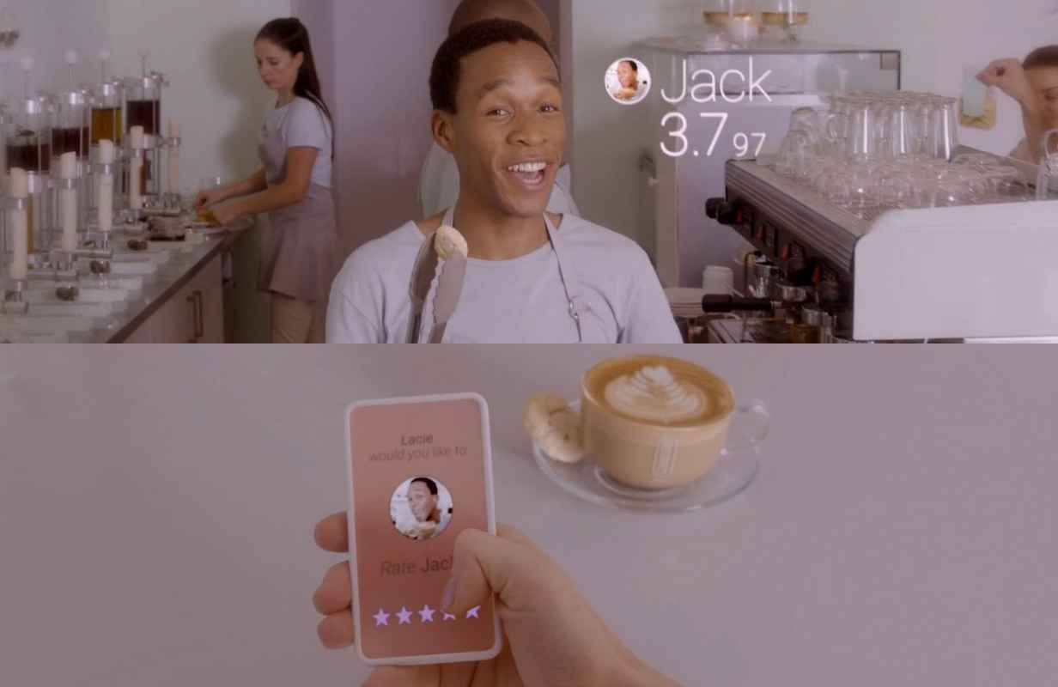
Productivity & usefulness measuring

Slide 9

Decision engines
E.g. You define requirements for the project, machine selects matching (the best) candidates.
How it works?
Regression analysis
Decision trees
Genetic algorithms
Machine Learning

Slide 10
Google's artificial intelligence can diagnose cancer faster than human doctors
The system is able to scan samples to determine whether or not tissues are cancerous
http://www.mirror.co.uk/tech/googles-artificial-intelligence-can-diagnose-9975987

Slide 11
AI advantages
Parallel work
Absolute knowledge database
The best algorithms
(Almost) unlimited resources

Slide 12

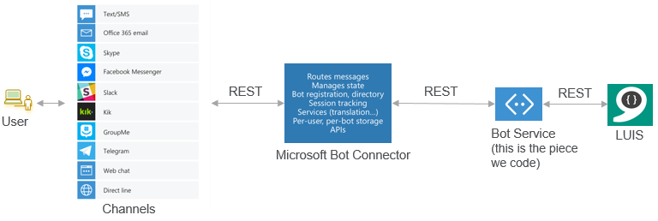
Chatbots and Assistants

Slide 13
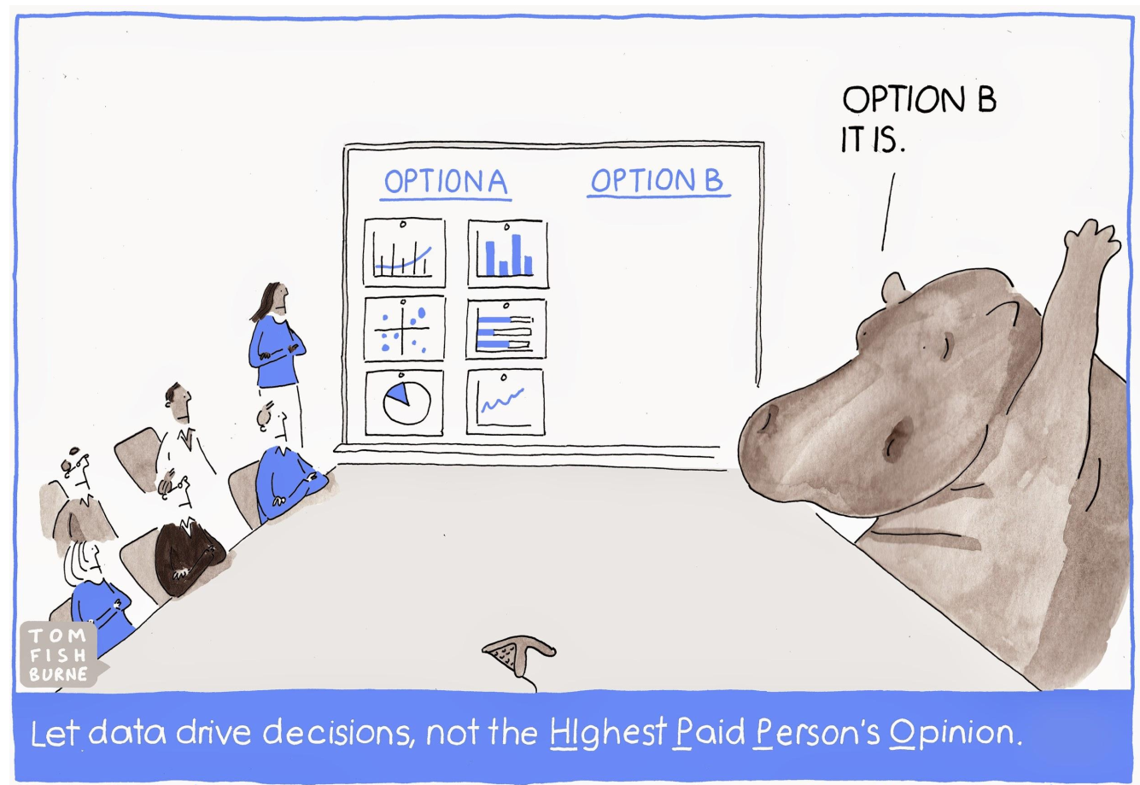
Data Driven Project Management
Let data drive decisions, not the HIghest Paid Person’s Opinion.

Slide 14
Data Driven Development
When a Story will get done?
1. You can get this story within X days with 85% probability.
2. Probability of you getting it within a week is Y%

Slide 15
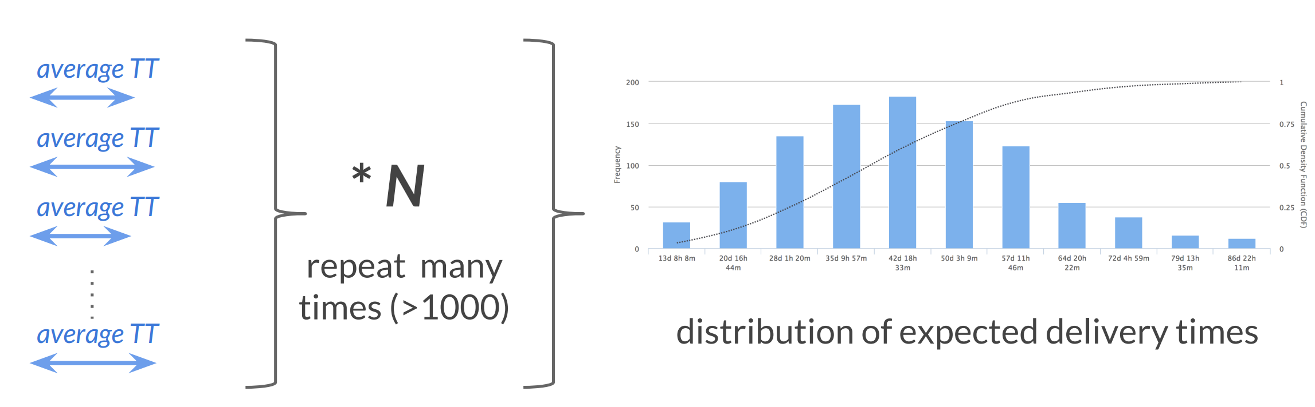
Predicting delivery time for N items
TT - Takt Time samples based on similar project

Slide 16
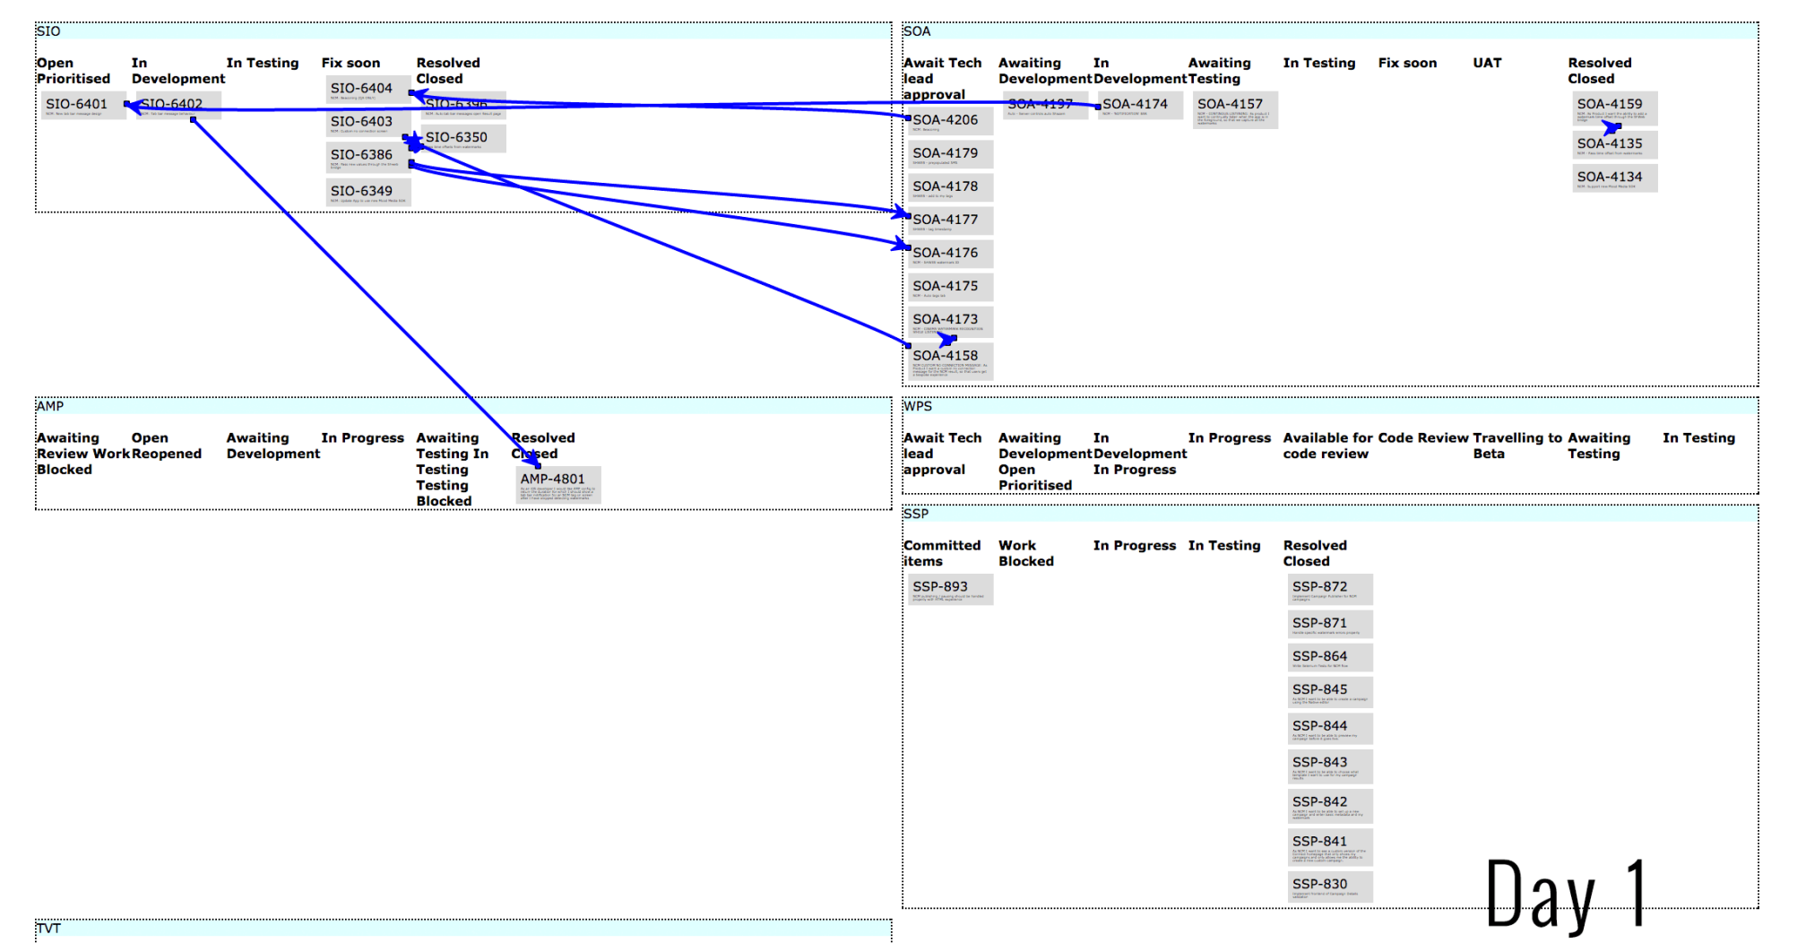
Dependencies and blockers As a Project Manager, what should I focus on next?

Slide 17
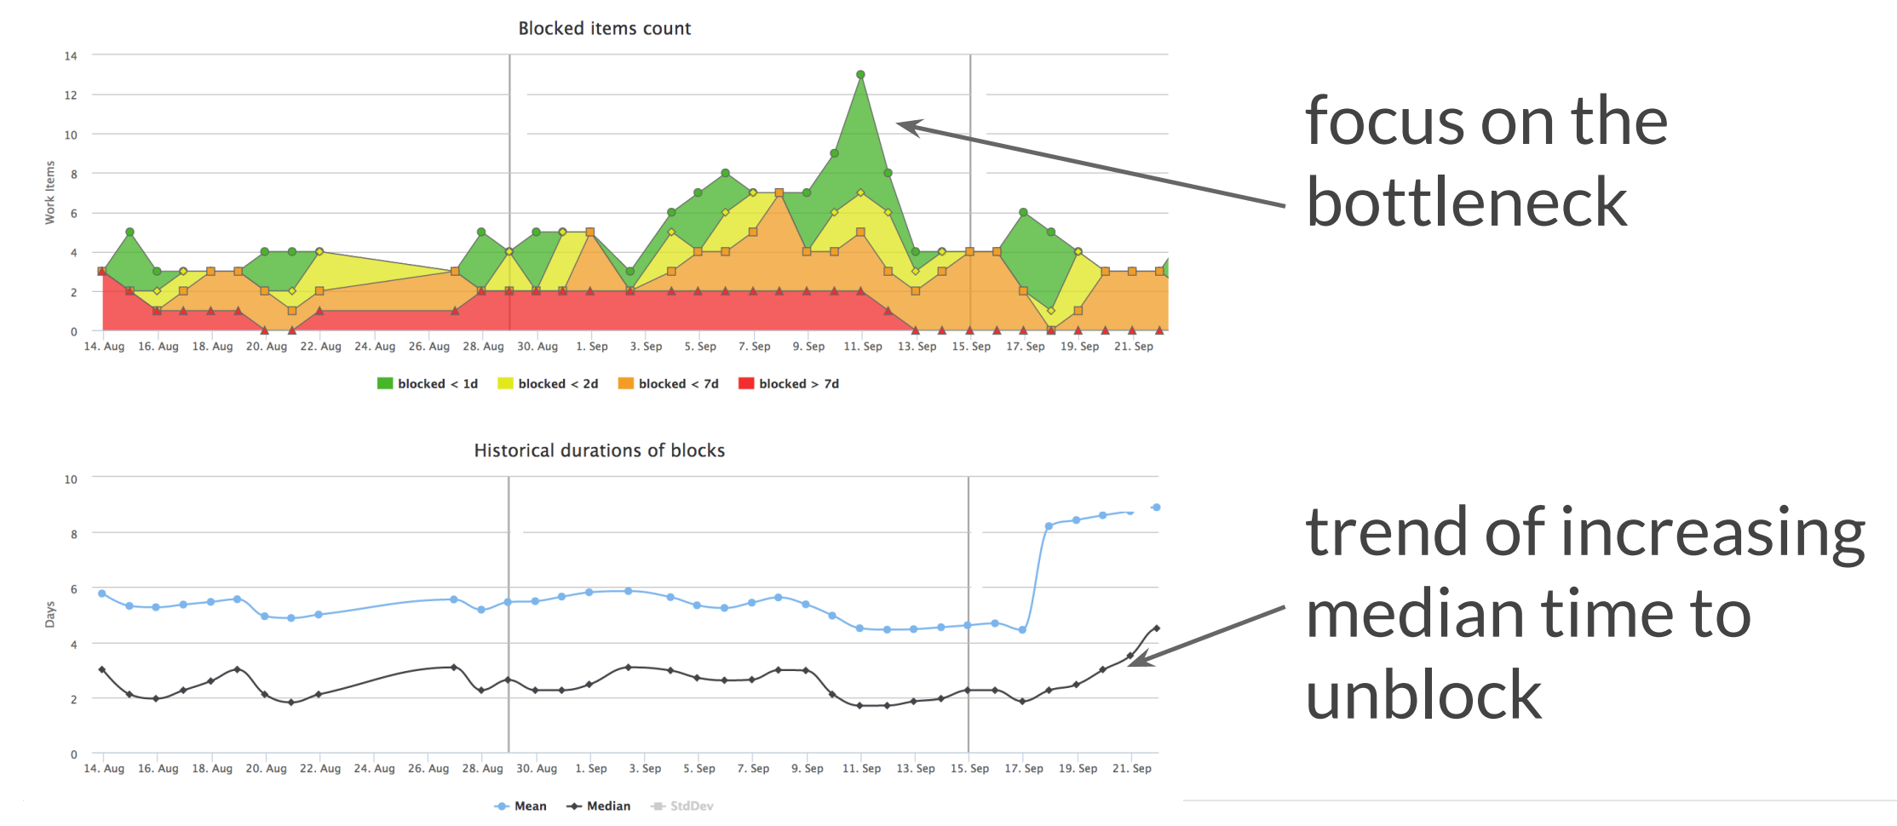
Dependencies and blockers Blockers statistics

Slide 18
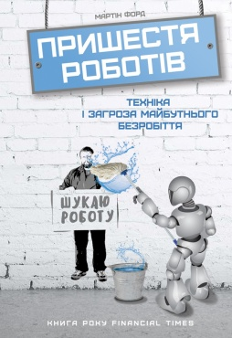
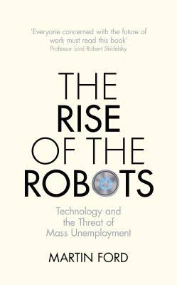
What to read?
Мартін Форд
The rise of the Robots Пришестя роботів. Техніка і загроза майбутнього безробіття.
http://nashformat.ua/catalog/knygy/biznes_1/kniga_prishestya_robot_v_tekhn_ka_zagroza_maybutnogo_bezrob_ttya_mart_n_ford/

Slide 19

What to read?
Ник Бостром
Искусственный интеллект
Этапы. Угрозы. Стратегии
http://www.mann-ivanov-ferber.ru/books/iskusstvennyj-intellekt/

Slide 20

Q&A
Oleksandr Krakovetskyi
CEO DevRain Solutions
alex.krakovetskiy@devrain.com
@msugvnua
https://www.facebook.com/alex.krakovetskiy

